Slide 1
Smart Wheelchair
TEAM: COMPUTER PLAYER
Names: Aneek Chattopadhyay
haoxiang XU

Slide 2
Introduction - Background
Smart wheelchairs help elderly or physically disabled individuals move independently.
They improve personal freedom, reduce reliance on caregivers, and allow users to perform everyday activities such as moving around the house or attending events.

Slide 3

Introduction - Motivation
Traditional powered wheelchairs require manual control, which limits use for people with severe disabilities.
Smart wheelchairs with autonomous navigation and human-following functionality offer a solution.
These are rare in Singapore and mostly at the research stage.

Slide 4
Problem Statement
Existing powered wheelchairs lack autonomous navigation and user-following features, which limits mobility and independence for users who cannot manually control the device.

Slide 5
Technical Gaps and Challenges
Mapping: LiDAR struggles to detect obstacles like glass and has undetected zones.
Navigation: Real-time obstacle avoidance and map updates are difficult due to dynamic environments.

Slide 6
Diagram

Slide 7
Project Objectives and Goals
Develop a smart wheelchair with autonomous indoor navigation and user-following functionality. Use LiDAR for real-time mapping and path planning, and a camera with YOLO for tracking. Aim to reduce manual control needs and improve mobility and safety.

Slide 8
Works Completed
- Created CAD model of wheelchair and simulated automatic navigation.
- Developed code for automatic mapping in enclosed environments.

Slide 9
Current Robot Animation

Slide 10
Proposed Approach
Improve simulation accuracy to reduce object penetration.
1
Integrate camera (Intel Depth Real Sense Camera) and LiDAR for better obstacle avoidance and user tracking.
2
Use Blender and A* algorithm to simulate navigation.
3
For the actual robot: Use Gazebo for real time mapping and navigation using rviz2.
4

Slide 11
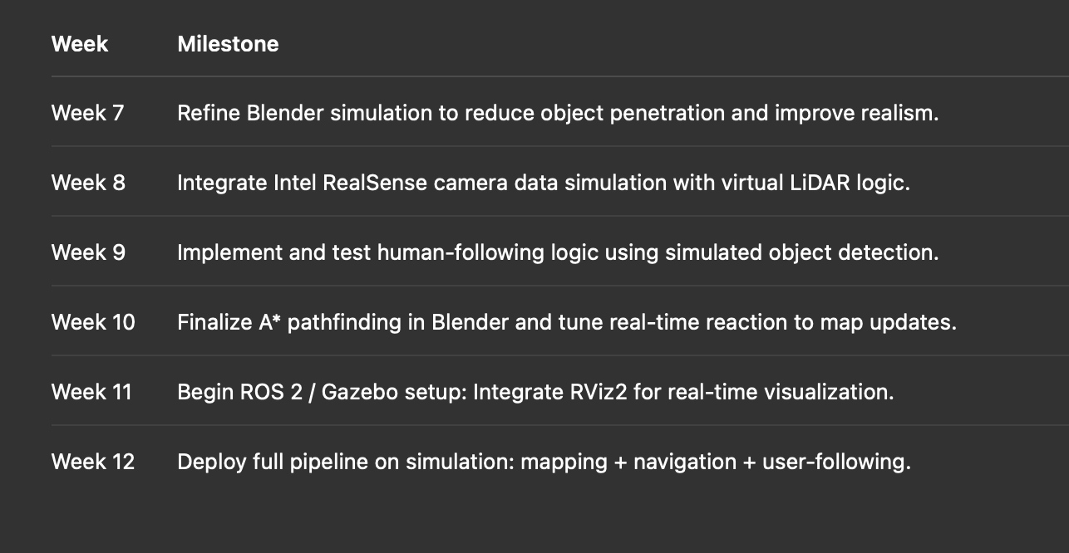
Timeline

Slide 12
Reference
Wang, S., Chen, H., Huang, Y., & Liu, W. (2019). Structural design and simulation analysis of a kind of multi-function intelligent wheelchair. Journal of Mechanical Transmission, 43(1), 40–44.
Cao, C., Trautman, P., & Iba, S. (2019). Dynamic Channel: A Planning Framework for Crowd Navigation. arXiv preprint arXiv:1903.00143.
Jung, D., Kim, C., Cho, J.-K., & Kim, S.-W. (2024). MuNES: Multifloor Navigation Including Elevators and Stairs. arXiv preprint arXiv:2402.04535.
Abdulla, A. A., Liu, H., Stoll, N., & Thurow, K. (2016). A new robust method for mobile robot multifloor navigation in distributed life science laboratories. Journal of Control Science and Engineering, 2016, 1–17.
Siegwart, R., Nourbakhsh, I. R., & Scaramuzza, D. (2011). Introduction to Autonomous Mobile Robots (2nd ed.). MIT Press.

Slide 13
Thank You

